Slide 1


Student Leader’s 2021
Elective Choices

Slide 2
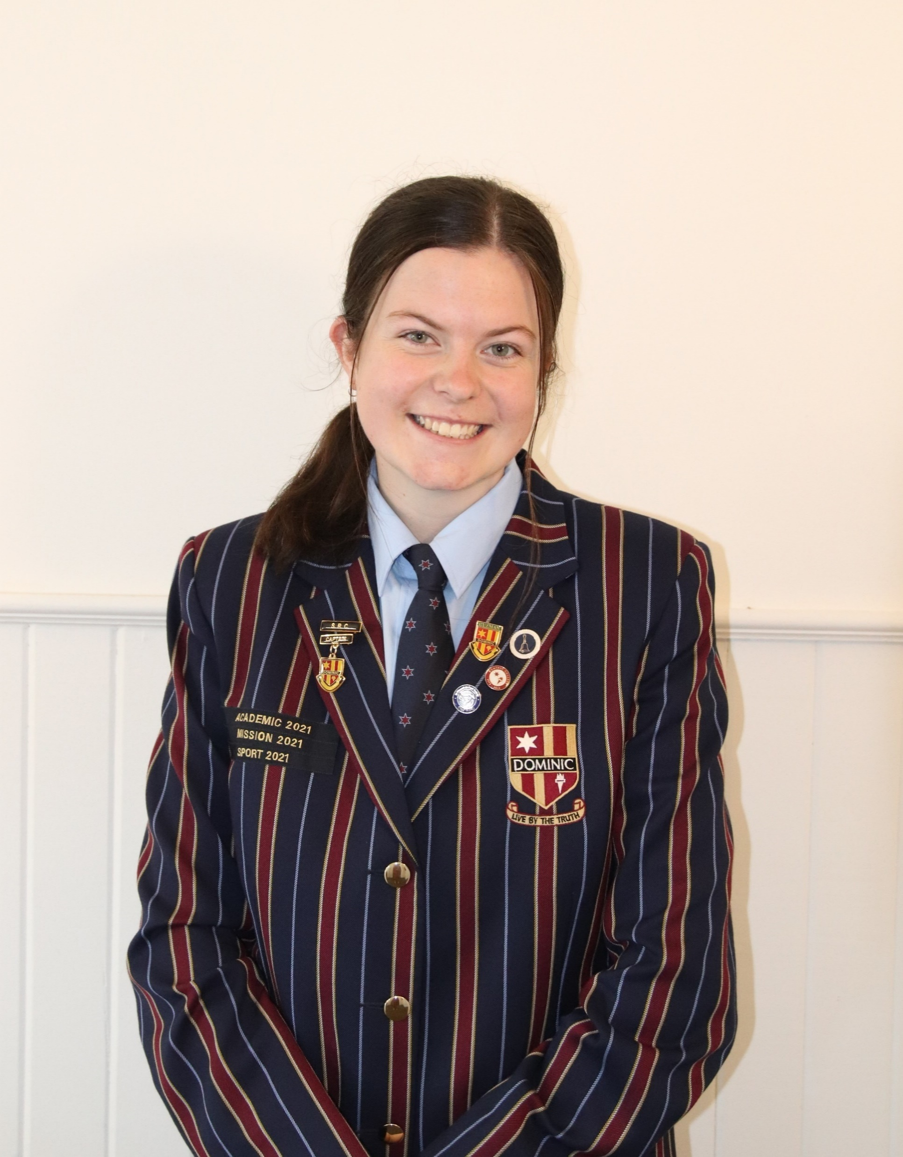

Rachael Glidden
Year 8 | Year 9 | Year 10
Drama | Child Studies | Creative Writing
Home Economics | Introduction to Psychology and Sociology | Life Sciences
Music | Sport Science | Sport Science
Visual Art

Slide 3

Justin Goodrick
Year 8 | Year 9 | Year 10
Digital Technologies | Animal Husbandry and Marine Studies | Geography
Drama | Introduction to Psychology and Sociology | Life Sciences
Japanese | Life Sciences | Physical Sciences
Music

Slide 4
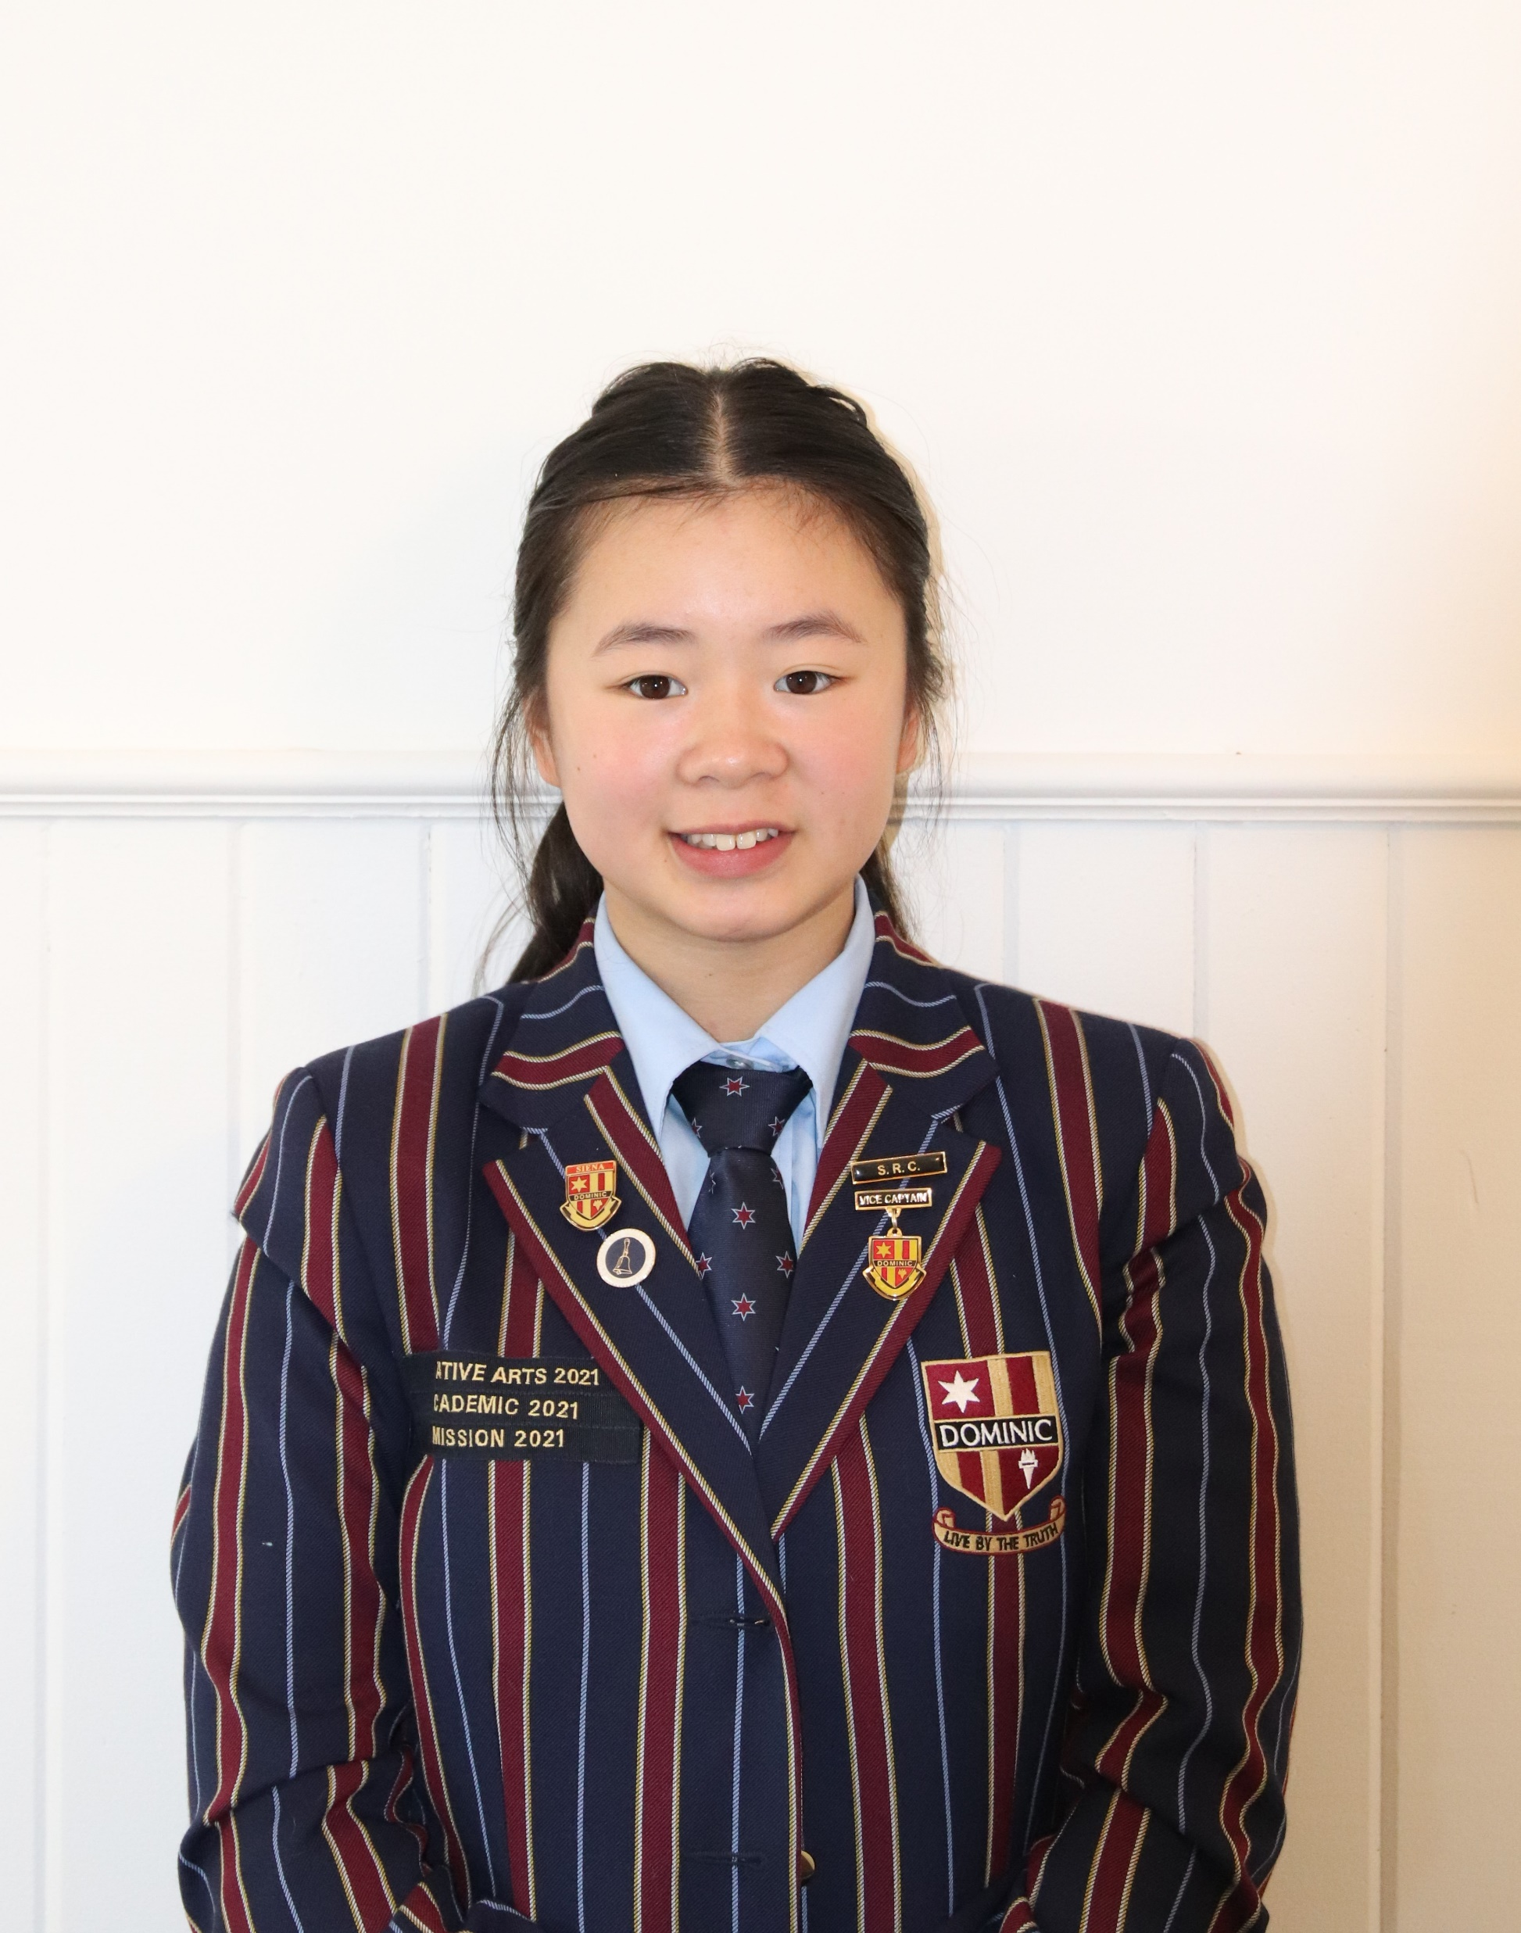
Zoelle Lin
Year 8 | Year 9 | Year 10
Digital Technologies | Dance | Maths 10A Plus
Dance | Life Sciences | Physical Sciences
Japanese | Japanese | Japanese
Music

Slide 5
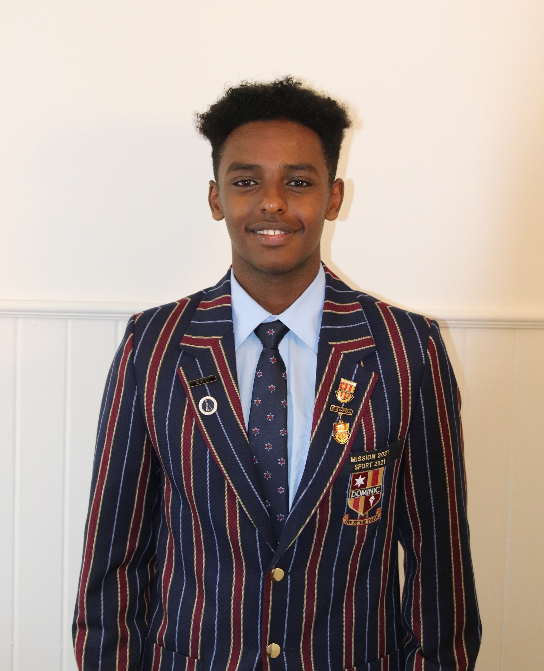
Solomon Kidane
Year 8 | Year 9 | Year 10
Drama | Athletic Development | Athletic Development
Home Economics | Media Arts | Commerce
Music | Sport Science | Sport Science
Visual Art

Slide 6

Sarah Watson
Year 8 | Year 9 | Year 10
Design in Wood | Animal Husbandry & Marine Studies | Animal Husbandry & Marine Studies
Home Economics | Food Technology | Outdoor Education
Drama | Visual Art | Introduction to Construction (VET)
Visual Art

Slide 7
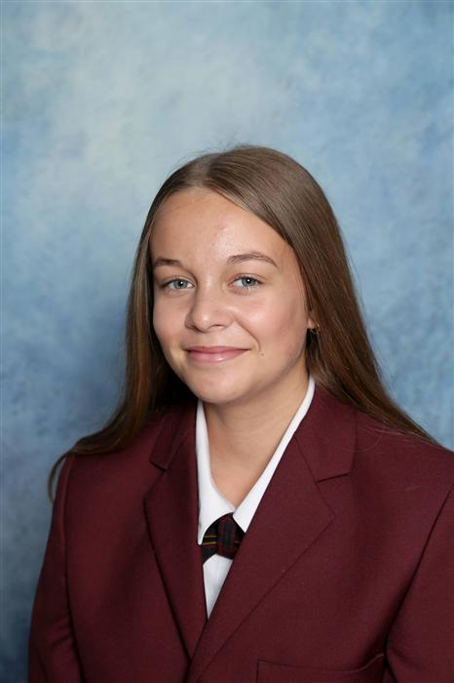
Lily Bowerman
Year 8 | Year 9 | Year 10
Dance | Music | Athletic Development
Home Economics | Food Technology | Child Studies
Drama | Outdoor Education | Visual Art
Music

Slide 8
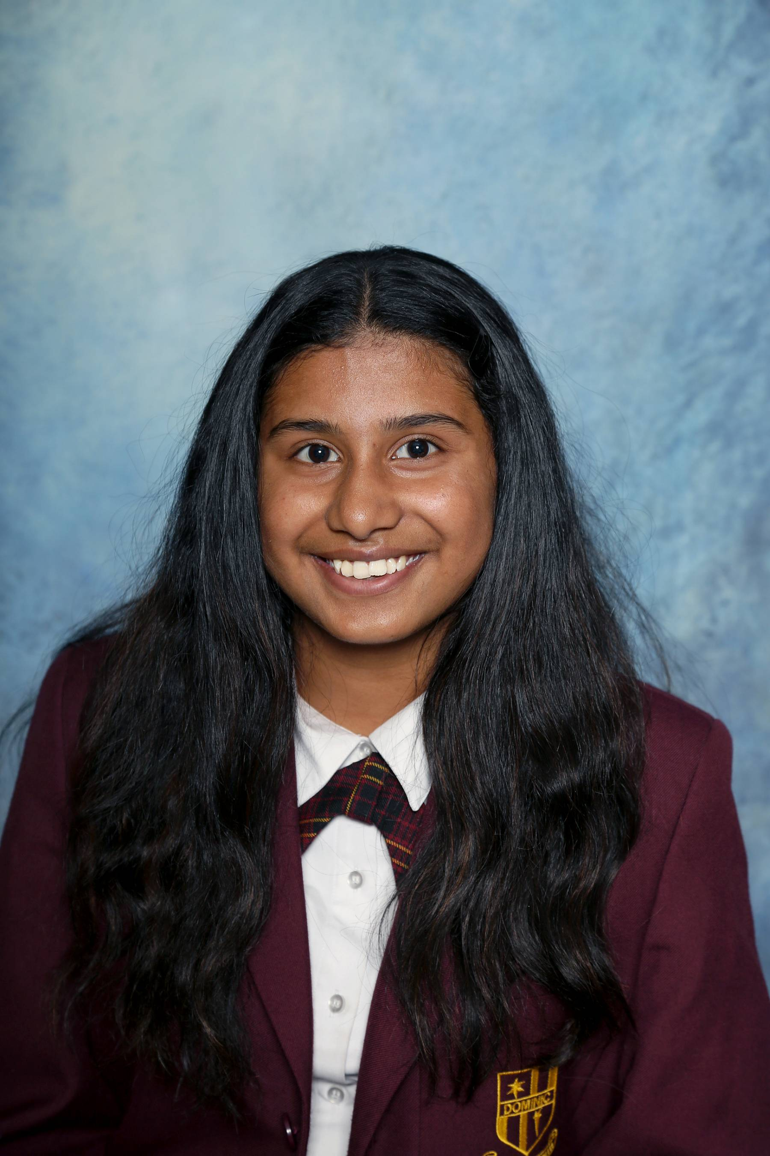
Rani Roy
Year 8 | Year 9 | Year 10
Dance | Drama | Commerce
Home Economics | Introduction to Psychology & Sociology | Child Studies
Drama | Media Arts | Drama
Japanese

Slide 9

Amy Bryant
Year 8 | Year 9 | Year 10
Dance | Creative Writing | Creative Writing
Digital Technologies | Life Sciences | Maths 10A Plus
Drama | Mathematics Extension | Media Art
Home Economics

Slide 10
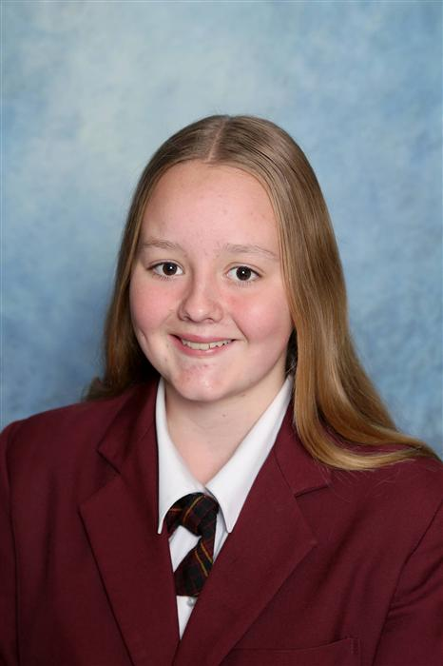
Carys Lavia
Year 8 | Year 9 | Year 10
Design in Wood | Commerce | Animal Husbandry and Marine Studies
Design in Metal | Outdoor Education | Drama
Drama | Mathematics Extension | Introduction to Psychology & Sociology
Dance

Slide 11
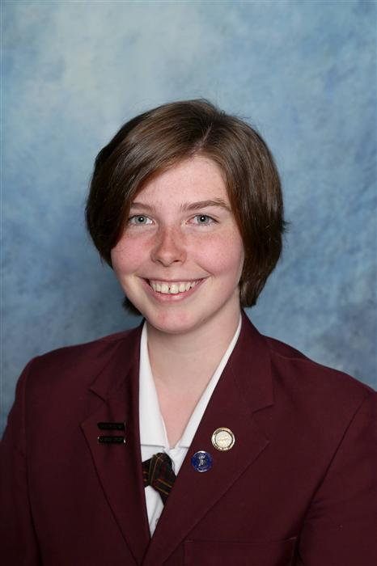
Jasmine Good
Year 8 | Year 9 | Year 10
Design in Wood | Music | Mathematics 10A Plus
Home Economics | Design in Wood | Visual Art
Music | Mathematics Extension | Introduction to Construction (VET)
Visual Art

Slide 12
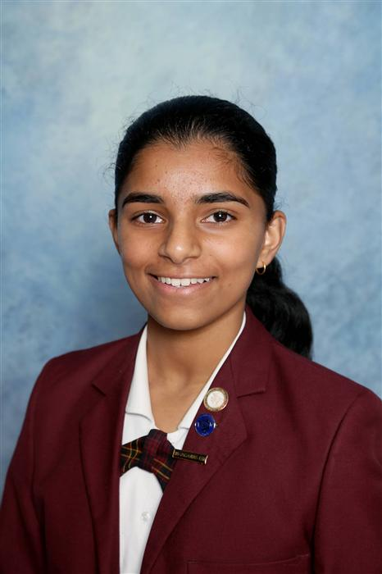
Priyanka Jibi
Year 8 | Year 9 | Year 10
Design in Wood | Media Arts | Mathematics 10A Plus
Home Economics | Sport Science | Life Sciences
Drama | Mathematics Extension | Sport Science
Visual Art

Slide 13

Tomas Murray
Year 8 | Year 9 | Year 10
Digital Technologies | Food Technology | Commerce
Home Economics | Media Arts | Physical Sciences
Japanese | Outdoor Education | Sport Science
Music

Slide 14
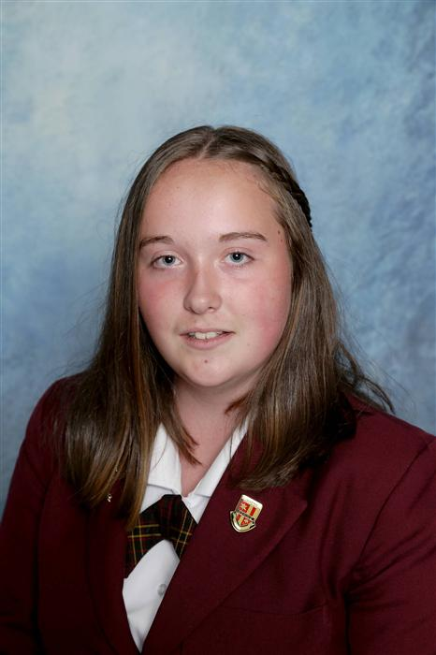
Bianca Russell
Year 8 | Year 9 | Year 10
Digital Technologies | Athletic Development | Drama
Home Economics | Drama | Introduction to Psychology & Sociology
Drama | Mathematics Extension | Sport Science
Japanese

Slide 15
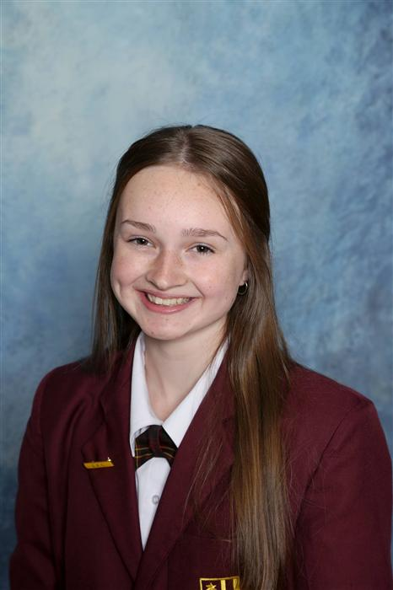
Hannah Lane MacDonald
Year 8 | Year 9 | Year 10
Dance | Athletic Development | Athletic Development
Home Economics | Dance | Dance
Music | Sport Science | Sport Science
Visual Art

Slide 16

Kitean Aitken
Year 9 | Year 10
Animal Husbandry & Marine Studies | Animal Husbandry & Marine Studies
Design in Wood | Athletic Development
Outdoor Education | Introduction to Construction (VET)

Slide 17
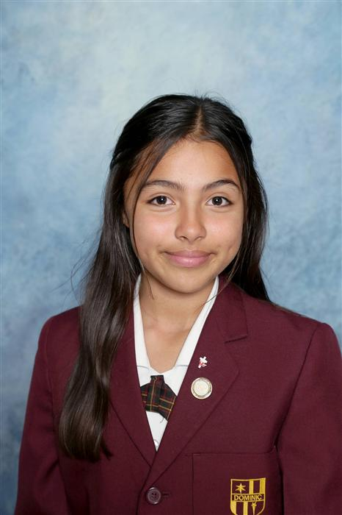
Andrea Escobar
Year 8 | Year 9 | Year 10
Drama | Introduction to Psychology & Sociology | Mathematics 10A Plus
Home Economics | Mathematics Extension | Physical Sciences
Visual Art | Sport Science | Visual Art
Music

Slide 18
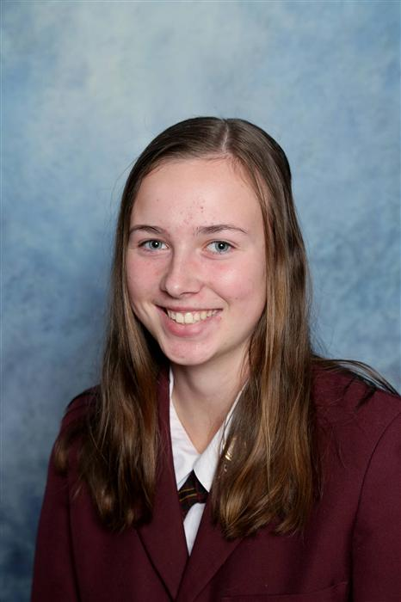
Taylah Chick
Year 8 | Year 9 | Year 10
Dance | Athletic Development | Athletic Development
Design in Wood | Dance | Sport Science
Visual Art | Sport Science | Dance
Music

Slide 19

Lachlan Majchrzak
Year 8 | Year 9 | Year 10
Digital Technologies | Athletic Development | Athletic Development
Design in Wood | Music | Physical Sciences
Visual Art | Mathematics Extension | Robotics & Game Making
Music

Slide 20

Alexa Sayer
Year 8 | Year 9 | Year 10
Drama | Creative Writing | Creative Writing
Home Economics | Music | Introduction to Psychology & Sociology
Visual Art | Food Technology | Mathematics Extension
Music

Slide 21
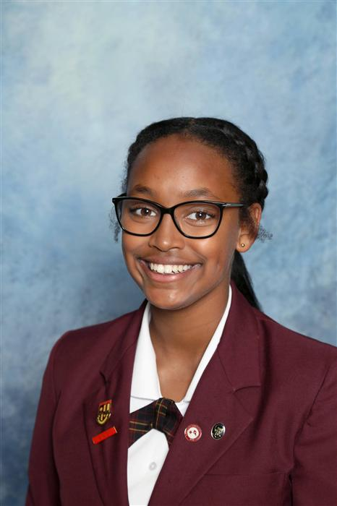
Hawi Bowerman
Year 8 | Year 9 | Year 10
Drama | Athletic Development | Dance
Home Economics | Dance | Introduction to Psychology & Sociology
Dance | Sport Science | Outdoor Education
Music

